Slide 1
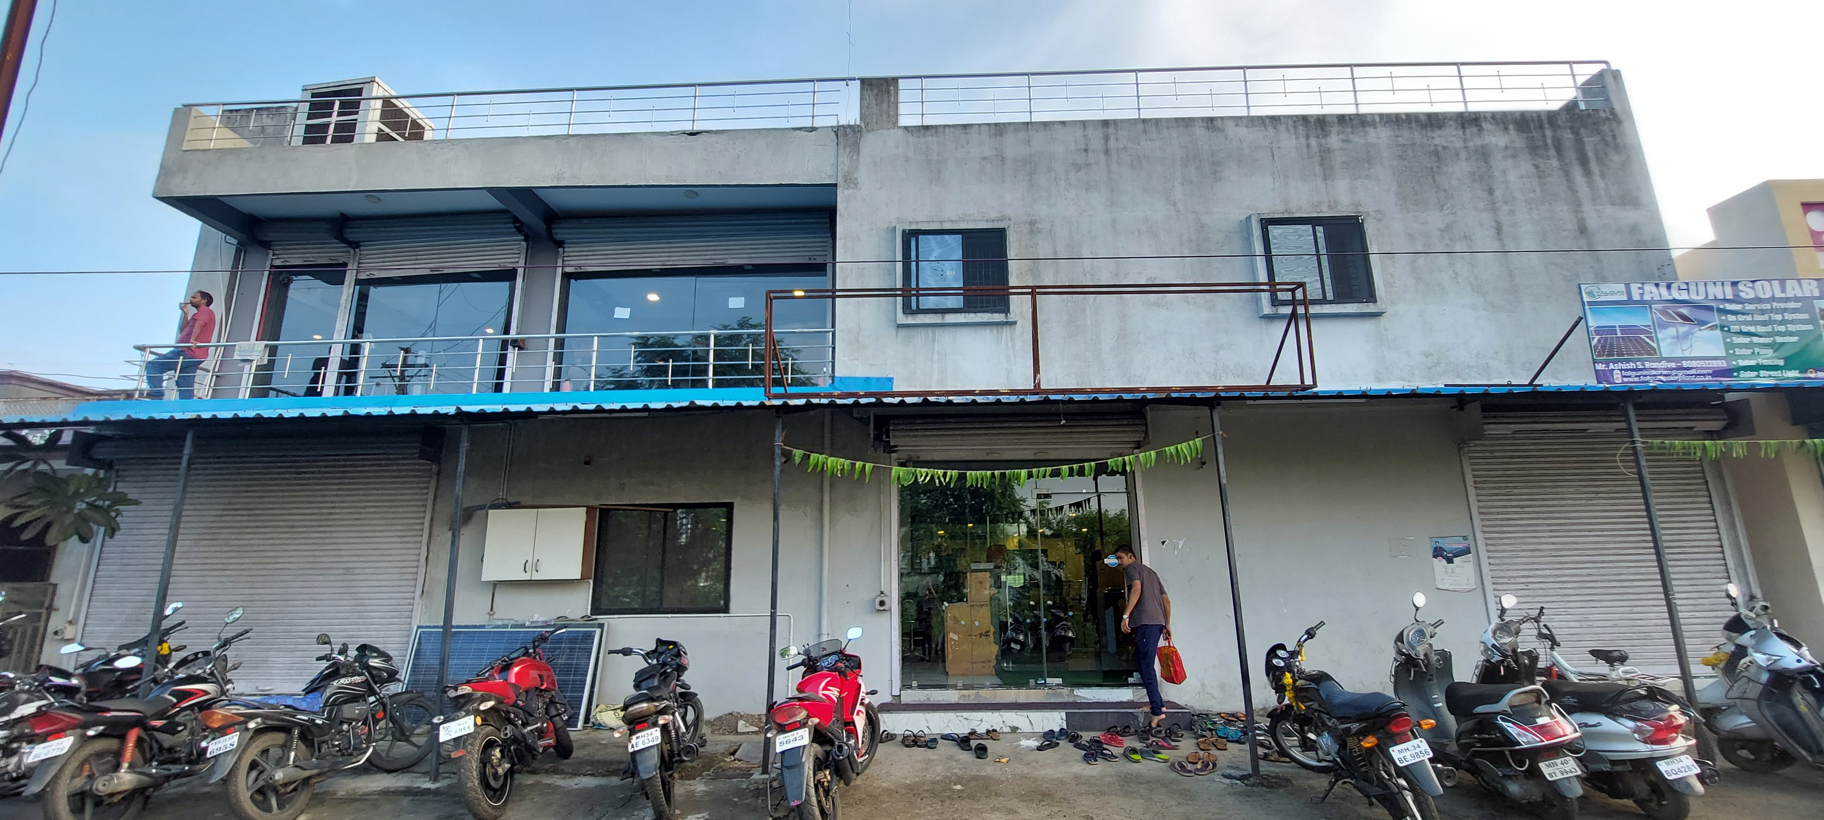
THE TRACK FITNESS CLUB
-By Arnav Kumar (21f2000426)

Slide 2
Contents
Executive Summary
Analysing the current situation
Analysis Method
Result and Findings
Recommendations
Month to Month revenue
Current Trends and Pattern
Overcrowding at peak hours
Retention Analysis
Overcrowding Analysis

Slide 3
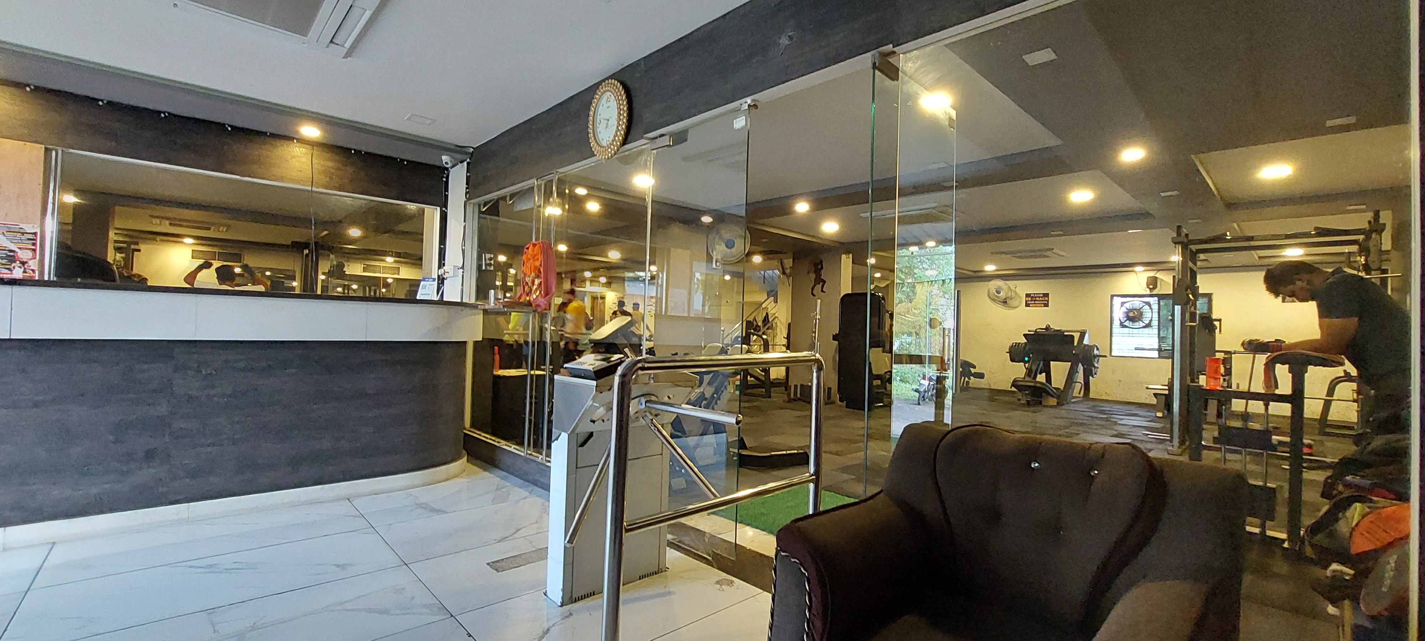
EXECUTIVE SUMMARY
Track Fitness Club Goals - Affordable Fitness, Addressing Overcrowding, Improving Retention
Improved Retention through Invoice Data Analysis and PII Cleaning
Data Analysis Overview (Jan-Aug 2022) - Utilized Microsoft Excel and Python for Visualization

Slide 4
1. Month to Month Revenue
ANALYSING THE CURRENT SITUATION
fig 1: Month-wise Revenue Breakdown
Monsoon Offer
January: ₹275,800 (18% of total)
March: 9% of 8-month revenue
August 2022 - Average Revenue: ₹190,530
Fig : 1

Slide 5
2. Current Trends and Patterns
Figure : 2
Figure : 3
New Client Registrations - Largest Drop in February (-50% compared to January)
Invoice Drop - June Joiners: 51% Didn't Recharge in July.

Slide 6
3. Overcrowding at peak hours
Figure : 4
Overcoming overcrowding improves equipment access, retention, and business success
Gym peaks at 7 AM and 6 PM with 4381 and 2955 workouts over 8 months

Slide 7
ANALYSIS METHOD
1. Factors contributing to Client Retention?
2. Any Clients with Flexible Gym Schedule?
3. What is Adherence Rate?
Clean Data
Address the low client retention
Identify dedicated clients
Find committed gym clients traits
Artificially Create & Nurture These Traits
Identify flexible clients preferring evening-noon slots
Employ Personalised scheduling
Address overcrowding
Identify flexible clients
Active Flexible Schedule Clients
All Unique Clients
Flexible Schedule Clients
Gym Dedicated Clients
Figure : 5
Figure : 6

Slide 8
RESULTS AND FINDINGS
1. Retention Analysis
Fig A’s Represents Overall Client Scenario,
Fig B’s Represents High AR clients Scenario
High AR Client-Trainer Association is 69% Overall Client-Trainer Association at 19%
Overall Female Representation: 22%
High AR Female Clients Representation: 14% (8% Drop)
Figure : 7A
Figure : 8A
Figure : 7B
Figure : 8B

Slide 9


2. Overcrowding Analysis
Figure : 9A
Figure : 9B
Figure 9A shows a gym peak at 7 AM and 6 PM, suggesting possible overcrowding
Figure 9B: Flex clients evenly spread workouts, reducing overcrowding peaks seen in Figure 9A
Should I go to the gym today? There is a lot of rush at this hour, maybe I will join another gym…
I feel more comfortable in the gym now, maybe because the rush at the peak hours is decreased somehow!! Anyway lets go workout!!

Slide 10

RECOMMEDATIONS FOR THE BUSINESS
What to do ?
What not to do ?
1. Maximize retention by offering discounted personal training, like a New Year special with reduced rates for a limited time
1. Avoid plain subscription discounts; past data shows they didn't retain clients, worsened overcrowding, and didn't increase revenue or profits.
2. Offer special discounts for Flexible clients choosing noon-evening slots (11 am to 4 pm)
2. Use price-cut promotions cautiously to preserve the perceived value of the business offerings; consider avoiding them entirely
3. Hire a Female personal trainer

Slide 11
THANKYOU!

